Slide 1
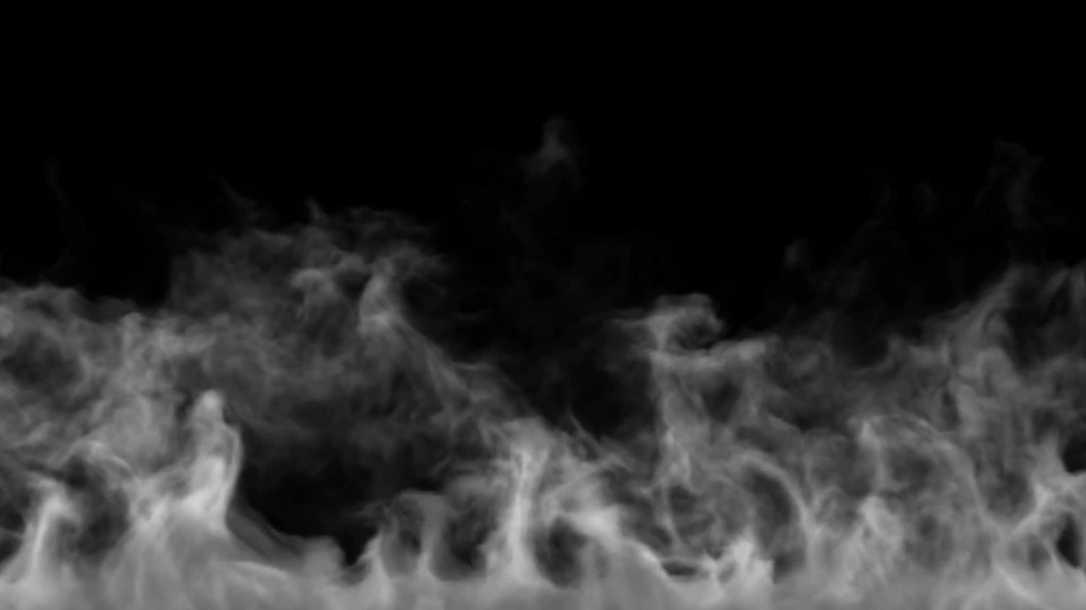
IoT-Based Smoke Detection Using AI
Detect smoke with the help of IOT data and trigger a fire alarm.
BY
DAKSH KHATRI
DIANE ALHERI ONEN
SERGEY DUBROVSKIY

Slide 2

Introduction
According to Wikipedia A smoke detector is a device that senses smoke, typically as an indicator of fire. Smoke detectors are usually housed in plastic enclosures, typically shaped like a disc about 150 millimetres (6 in) in diameter and 25 millimetres (1 in) thick, but shape and size vary. Smoke can be detected either optically (photoelectric) or by a physical process (ionization). Detectors may use one or both sensing methods. Sensitive alarms can be used to detect and deter smoking in banned areas. Smoke detectors in large commercial and industrial buildings are usually connected to a central fire alarm system.
The author of this dataset has successfully created a smoke detection device with the help of IOT devices, and our goal is both to create a machine learning model to predict the fire alarm.

Slide 3

About Dataset
Collection of training data is performed with the help of IOT devices since the goal is to develop a AI based smoke detector device. Many different environments and fire sources have to be sampled to ensure a good dataset for training. A short list of different scenarios which are captured:
Normal indoor Normal outdoor Indoor wood fire, firefighter training area Indoor gas fire, firefighter training area Outdoor wood, coal, and gas grill Outdoor high humidity etc. The dataset is nearly 60.000 readings long. The sample rate is 1Hz for all sensors. To keep track of the data, a UTC timestamp is added to every sensor reading.

Slide 4
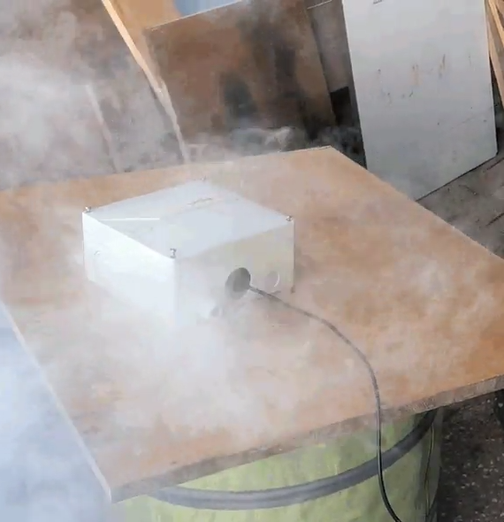
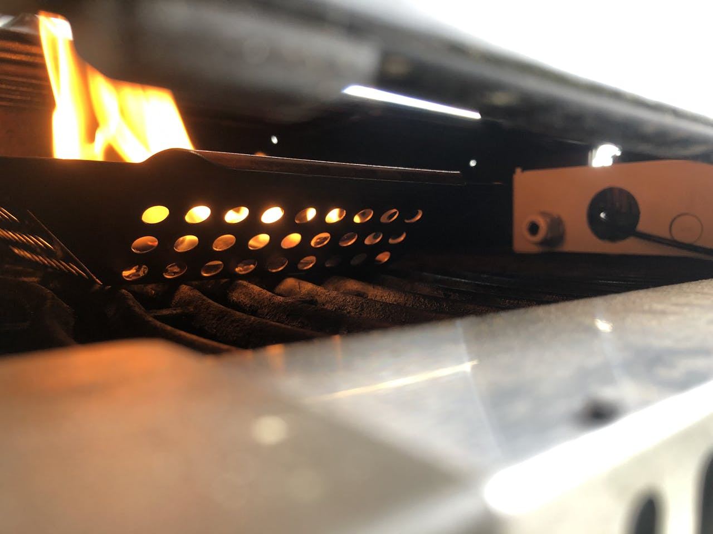
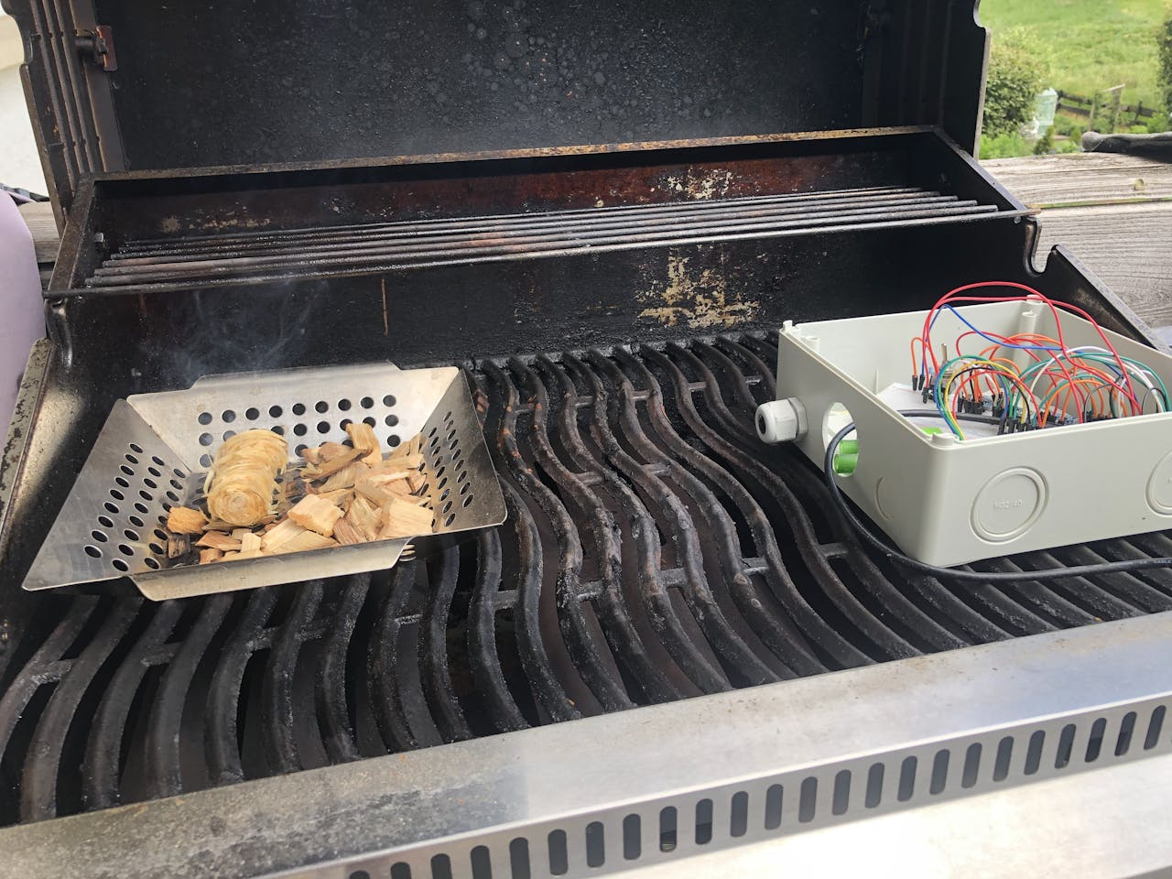
Some impressions
Professional Smoke Machine
Wood fire
Gas/ Wood fire

Slide 5

Project Objective and Scope
Objective:
Develop an AI-based smoke detection device leveraging IoT sensors.
Scope:
Integration of various IoT sensors to collect environmental data.
Use of AI algorithms to accurately predict the presence of smoke/fire.
Deployment in varied environments to ensure reliability.

Slide 6
About the features
UTC - The time when experiment was performed.
Temperature - Temperature of Surroundings. Measured in Celsius
Humidity - The air humidity during the experiment.
TVOC - Total Volatile Organic Compounds. Measured in ppb (parts per billion)
eCo2 - CO2 equivalent concentration. Measured in ppm (parts per million)
Raw H2 - The amount of Raw Hydrogen present in the surroundings.
Raw Ethanol - The amount of Raw Ethanol present in the surroundings.
Pressure - Air pressure. Measured in hPa
PM1.0 - Particulate matter of diameter less than 1.0 micrometer .
PM2.5 - Particulate matter of diameter less than 2.5 micrometer.
NC0.5 - Concentration of particulate matter of diameter less than 0.5 micrometers.
NC1.0 - Concentration of particulate matter of diameter less than 1.0 micrometers.
NC2.5 - Concentration of particulate matter of diameter less than 2.5 micrometers.
CNT - Simple Count.
Fire Alarm - (Reality) If fire was present then value is 1 else it is 0.

Slide 7
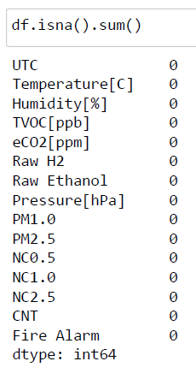
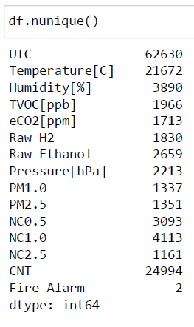
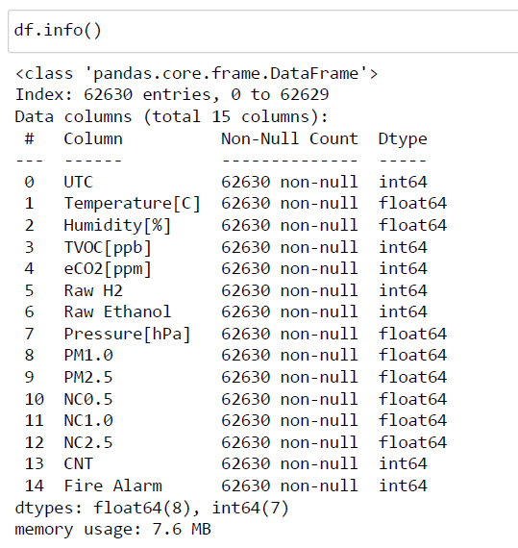
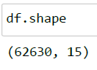
Understanding the Dataset
There are total of 62360 rows and 15 coloumns in data.
Data contains no missing value.
We do not have any categorical feature
There are a total of 810680 (62360 x 13) observations .

Slide 8
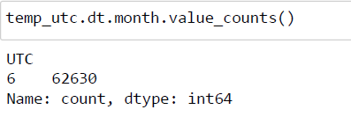
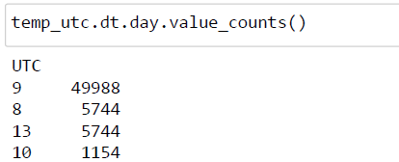
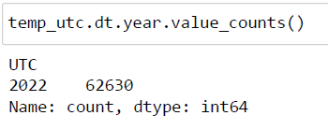
Exploring the time when the data was recorded.
The data is recorded in 2022 in the 6th month.
We further categorize the data using the hour values into Night, Morning, Afternoon, Evening.

Slide 9
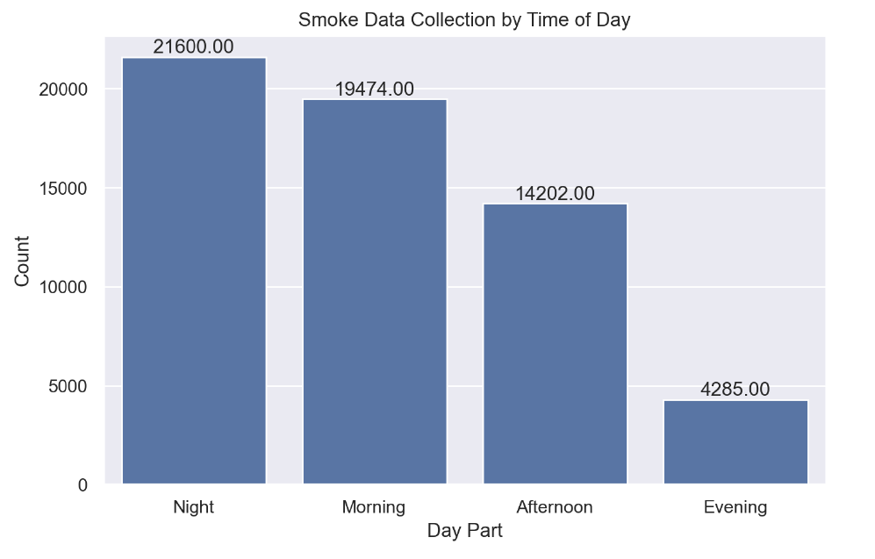
Insights
Nighttime Dominance: The data indicates that most of the activity or events occurred during the night (UTC). This represents approximately 40% of the total occurrences.
Morning Peak: The morning period (UTC) also saw a substantial number of events, constituting around 36% of the total.
Afternoon and Evening: The afternoon and evening periods combined account for less than 34% of the total occurrences, suggesting a lower activity level during these times.

Slide 10
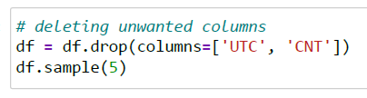
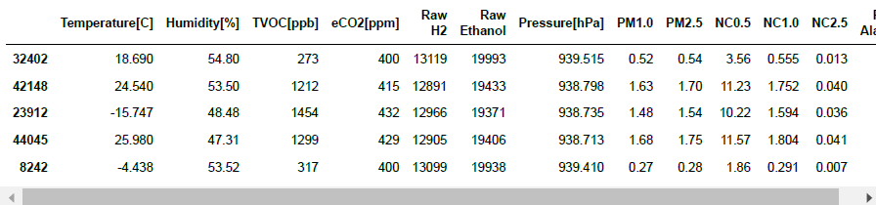
Removing the unwanted columns

Slide 11
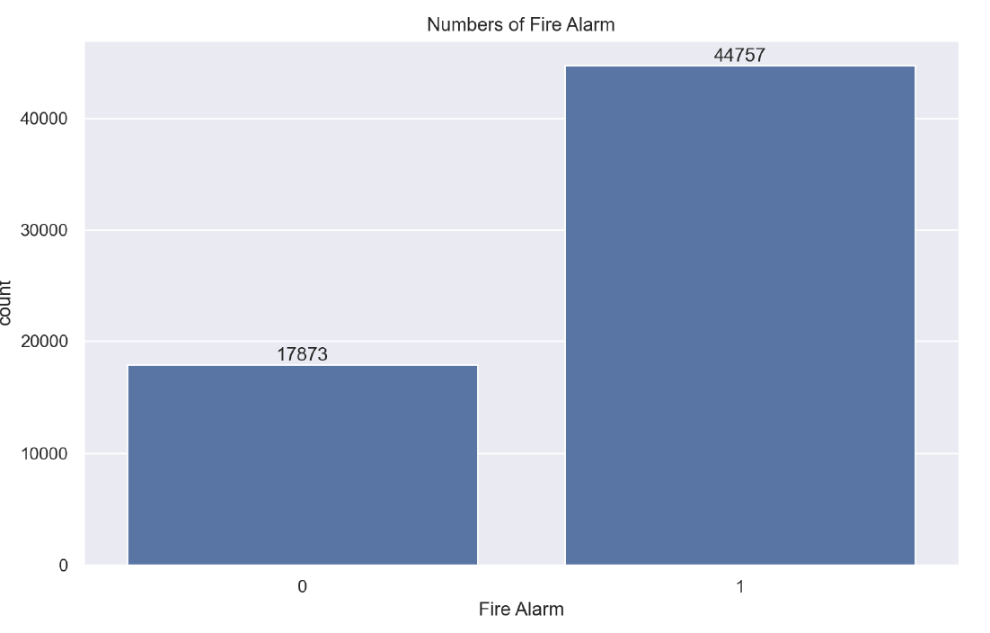
Exploratory Data Analysis (EDA)
Class Imbalance: The dataset exhibits a significant class imbalance, with the positive class (1) being more prevalent than the negative class (0). This imbalance can impact model performance and evaluation metrics.
Model Bias: There's a potential risk of the model becoming biased towards predicting the majority class (1). This can lead to inaccurate predictions for the minority class.
Evaluation Metrics: Standard accuracy might not be a reliable metric due to the class imbalance. Precision, recall, F1-score are more suitable for evaluating model performance.
Imbalanced Dataset Handling Techniques: Explore various techniques like SMOTE, ADASYN, or cost-sensitive learning to mitigate the impact of class imbalance.

Slide 12
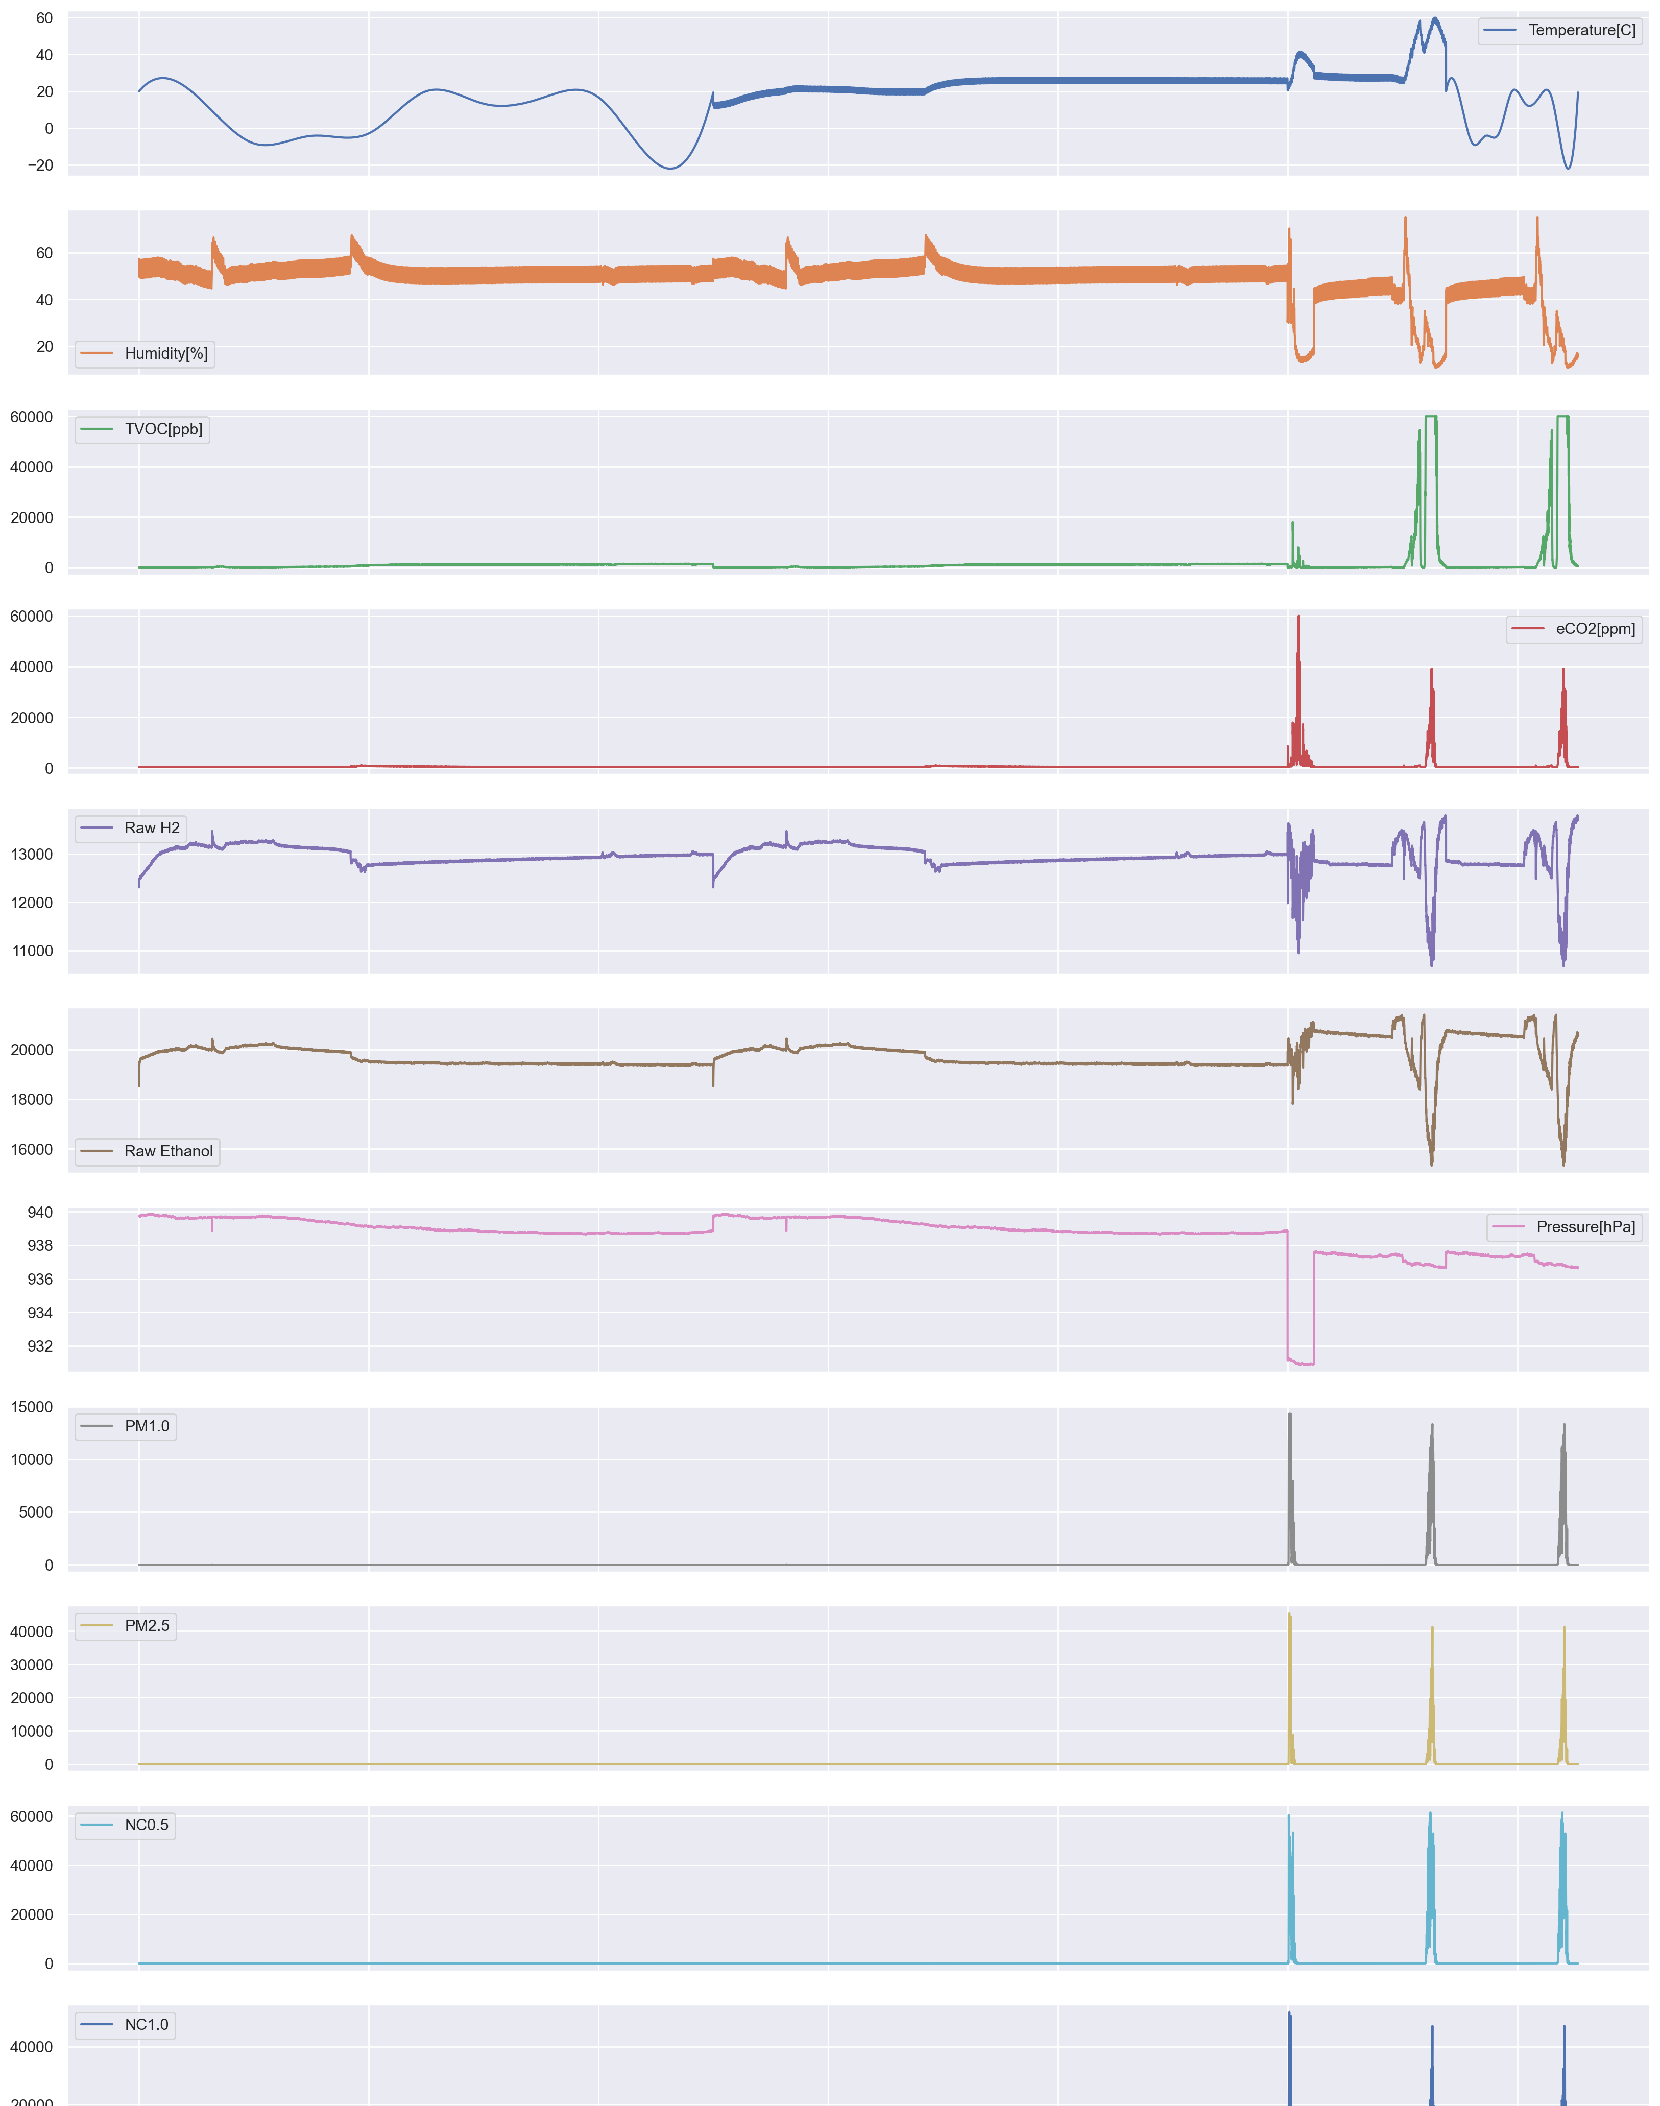
Univariate Analysis
From the graph strong relationship is found between the variables
We can clarify it by using correlation matrix.

Slide 13
Plotting correlation matrix
Positive: Humidity and Pressure are the highest positive correlation to Target Variable
Negative: Temperature TVOC are the highest negative correlation to Target Varible

Slide 14
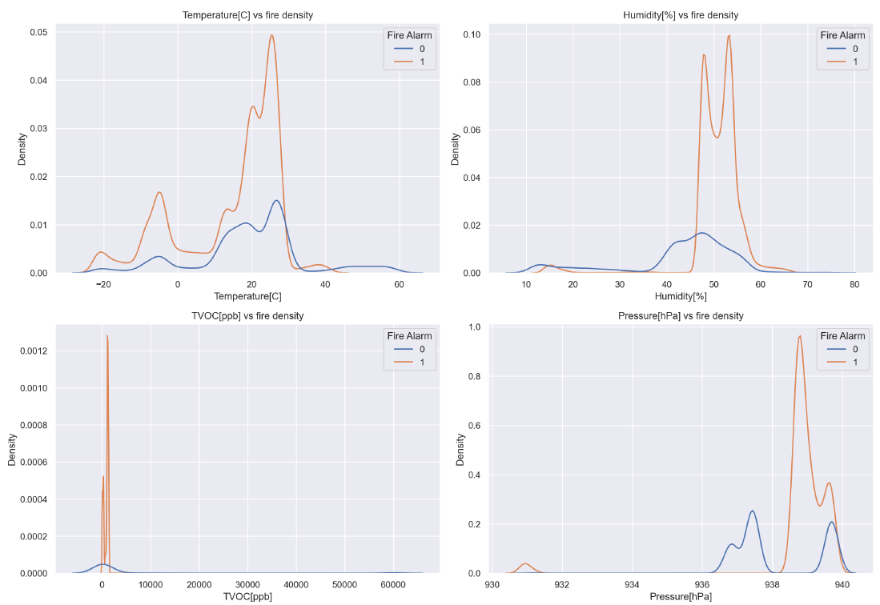
Bivariate Analysis
At different temperatures Fire may have higher density over No Fire
Humidity and Pressure seems to seen more when there’s a fire

Slide 15
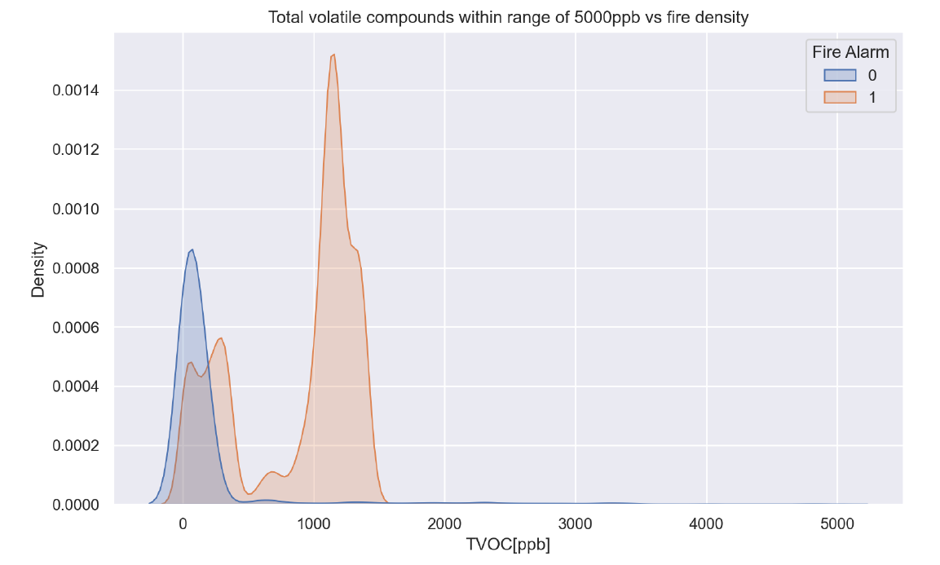
Total volatile compounds
From visualization of the graph, it can be analyzed that density of fire is are highest when Total Volatile Organic Compounds concentration is about 1000 to 1500 and at higher concentration of TVOC spread of density of yes fire and no fire is almost same

Slide 16
Avg. Concentrations
During no fire cases average value of concentration of PMs, NCs and eCO2 are high.

Slide 17
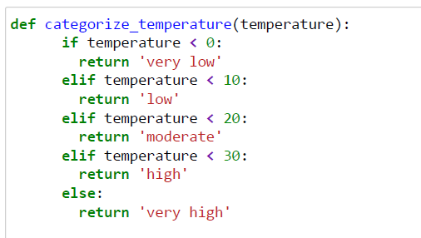
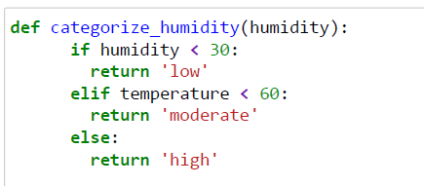
Creating categorical features
These 2 function will be used to categorize temperature and humidity feature.

Slide 18
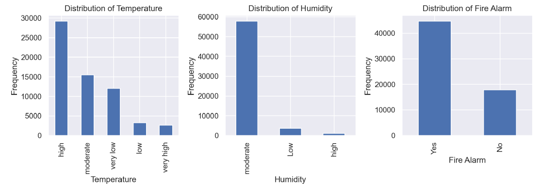
Insights
The majority of data points fall within the "high" temperature category.
The relatively low frequencies of "low" and "high" categories suggest limited representation of extreme humidity conditions in the dataset.

Slide 19


vs
Features | Amazon SageMaker | Databricks
Focus | Primarily focused on ML model development, training, and deployment. | Built around big data processing and analytics, with strong capabilities for collaborative work.
Use cases | Best for end-to-end ML workflows, including data preparation, model building, training, hyperparameter tuning, and deployment | Ideal for big data processing, ETL (extract, transform, load) workflows, and collaborative data analysis.
Core Technologies | AWS services | Built on top of Apache Spark
Integration | AWS services (Lambda, S3, EC2, etc) | Big data tools (Spark, Delta Lake, other 3rd party)
Ease of Use | User-friendly, especially for users familiar with the AWS ecosystem. It provides a lot of automation and managed services. | Designed with data scientists and engineers in mind, it offers more flexibility for custom workflows but may require more expertise
Pricing | Based on the use of compute resources
 | For machine learning model training (for smaller or more straightforward ML tasks) | For data processing and ETL tasks (especially when dealing with large datasets)
Speed | Faster for smaller ML training tasks or tasks that are well-integrated into the AWS | Faster for large-scale data processing and analytics tasks
Summary | If need is to develop, train, and deploy ML models within the AWS ecosystem. It’s ideal for end-to-end ML pipelines with strong support for managed services. | If needed a collaborative platform for big data analytics and ML, especially if you are working with large datasets.

Slide 20
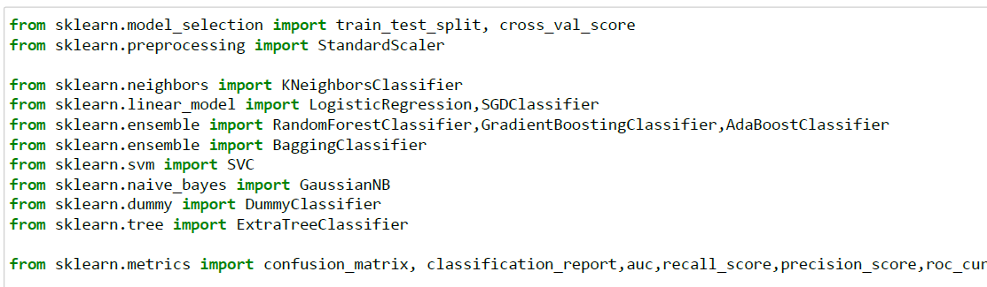
Data Modeling
Importing all the required libraries

Slide 21
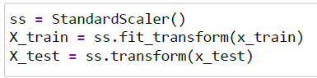
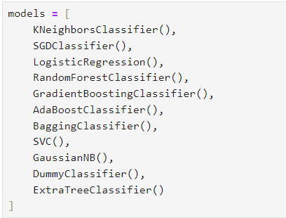
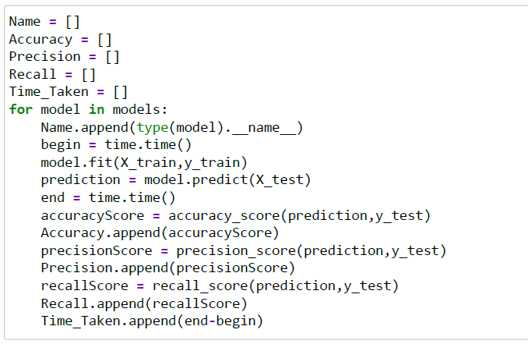
Scaling the data and preparing models

Slide 22
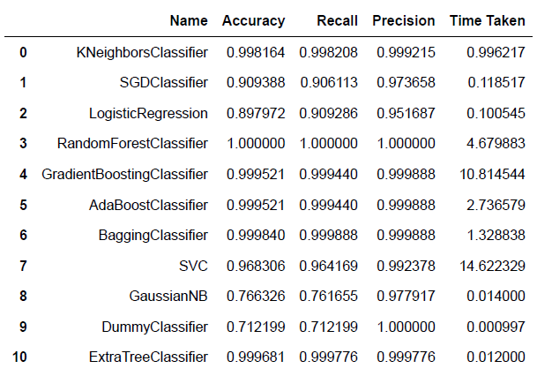
Metrics

Slide 23
Feature Importance

Slide 24
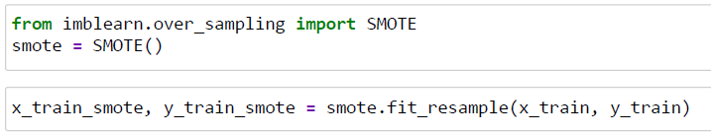
Handle Imbalance using SMOTE Over Sampling

Slide 25
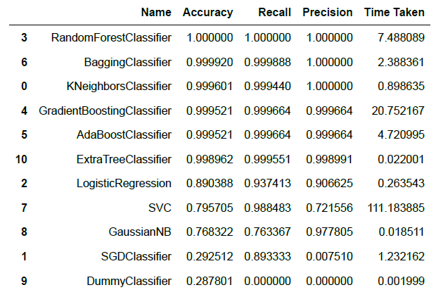
Metrics

Slide 26
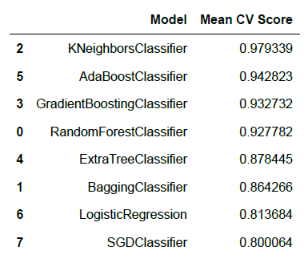
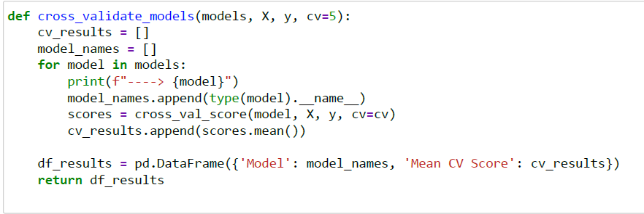
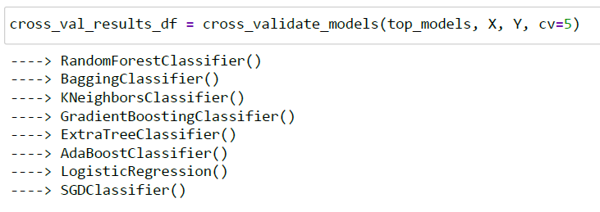
Cross Validation
Checking if our model is not overfitting since we are getting 99% accuracy.

Slide 27

Conclusion
Key Findings:
Effective utilization of IoT data for smoke detection.
Strong correlation between environmental factors and fire alarms.
High model accuracy achieved through RandomForest and GradientBoosting techniques.
Challenges and Limitations:
Data imbalance and the need for advanced techniques like SMOTE.
Potential overfitting due to the high accuracy of certain models.
Future Work:
Exploring other machine learning models for better generalization.
Deployment of the model in real-world scenarios for validation.

Slide 28
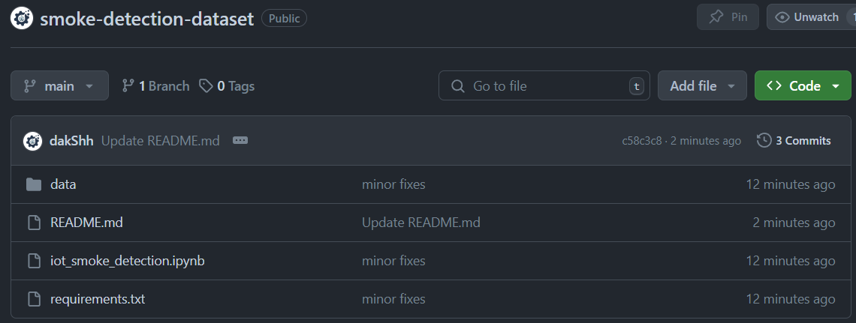
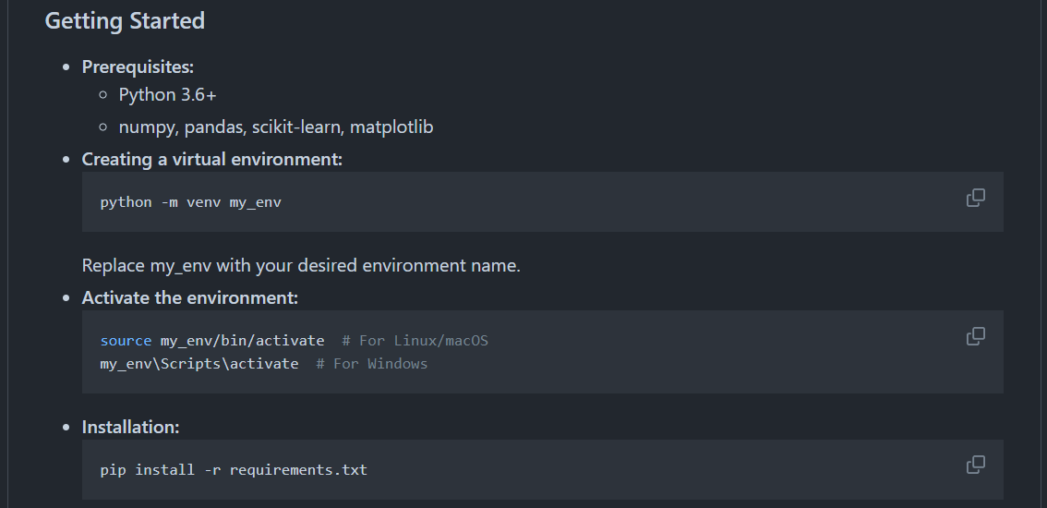
Github
The project is available on Github, along with
steps to get started with the project

Slide 29

Any Questions?

